Slide 1

CIPFA North East Annual Conference
Technology, Change & Sustainability
Dreaming or Reality? You Decide
1st December 2017
Martin Cresswell, CEO
Notes:
INTRO MYSELF
Director – been in mgt consultancy 8 years, Prior to that over 10 years in local government. On the side, lecturer in strategic management at university of London
Feels timely to be presenting this today with the new Blade Runner film out in cinemas.
But this isn’t sci fi – this is current technology that’s available and people are using it now
Talk about the opportunities presented by technology – for the public sector to be financially sustainable
Reflect on the challenges and why we’ve all heard of huge investment in technology projects (IT systems) that have been spectacular failures
How do we get the maximum benefits from technology

Slide 2

What’s in store for us?
Survey on life in 2016 of 1,000 British young adults aged 18 to 34:
· 26% are willing to date a robot, but only if it looks like a real-life human
· 50% using contactless bank cards would get a chip implant
· But 62% would not swap real food for a pill
“What does this mean for society?”
Notes:
The start of the 21st century has been marked by rapid technological development, with widespread impacts for both individuals and society.
The nature of our workforce, how we fight wars, the risks posed by disease, and even our bodies and brains are all being transformed by new technology
And we can expect the future to bring even more dramatic changes.
Yet, people often give a wry smile when I mention robotics
Whilst we may think this may seem like futuristic nonsense or sci fi
the level of technology available (including AI) has profound implications for us
Young people are not only open to it but have a huge appetite
Just take a look at these stats…
The UK is way behind when it comes to technology
And I would venture that the public sector is further behind still. I am always bemused when I visit a hospital and see the incredible machines and equipment – and then see batches of carboard folder and paper files being carried around with critical patient notes

Slide 3
What’s in store for us?
Reform think tank says Robots could replace 250,000 public sector workers (Source: Guardian 06/02/17)
Oxford Martin programme on technology and employment – 35% of jobs at risk through automation
“What does it mean for you?”
Notes:
The Oxford Martin Programme was a research project from 2011 – 2015 that looked at Impact of Future Technology
So what does it really mean for you? Do you feel like an endangered species?!

Slide 4
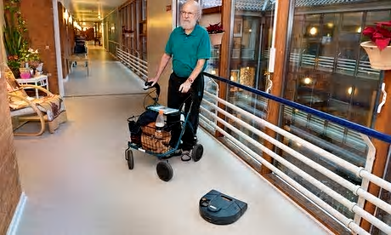
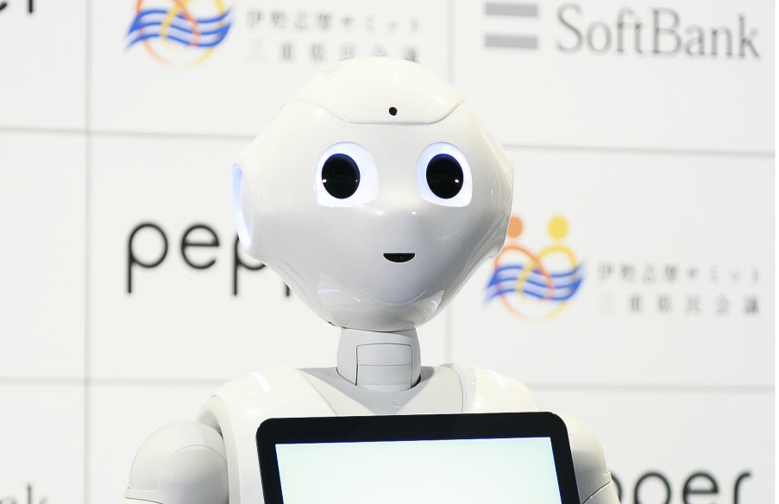
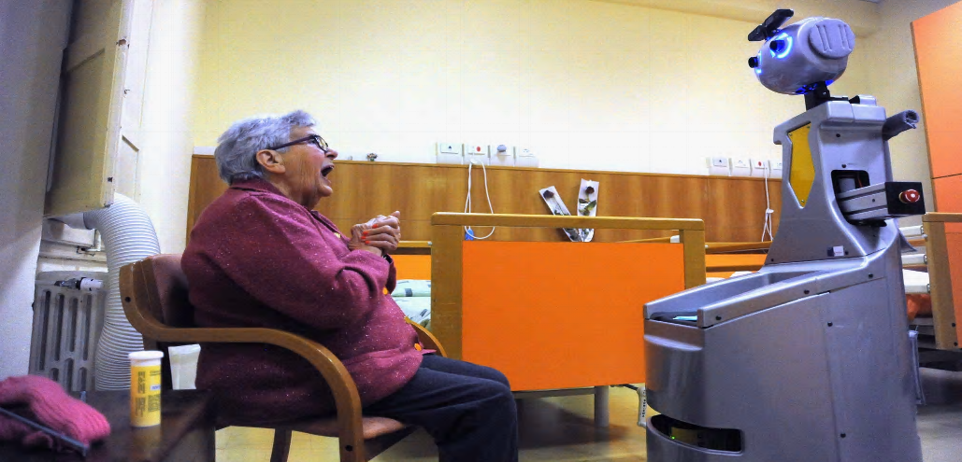
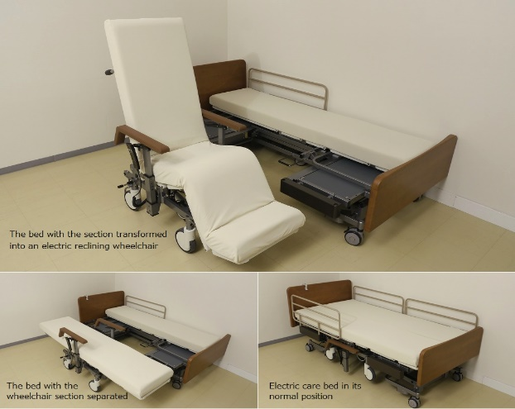
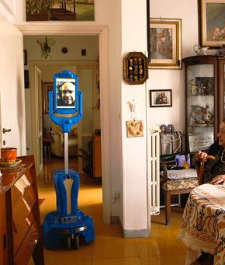
The future is here!
The future is already here!
Robotic trials for health and social care in Europe and Asia
UK is behind curve
Integral to demand management
Digital & artificial Intelligence
Notes:
Historically, robotics in industry meant automation, a field that asks how machines perform more effectively than humans.
These days, new innovation highlights a very different design space: what people and robots can do better together.
Instead of idolizing machines or disparaging their shortcomings, these human-machine partnerships acknowledge and build upon human capability.
From autonomous cars reducing traffic accidents, to grandparents visiting their grandchildren by means of telepresence robots, these technologies will soon be part of our everyday lives and environments.
What they have in common is the intent to support or empower the human partners with robotic capability and ultimately complement human objectives.

Slide 5
Adult Social Care : We know the challenge!
ASC funding is in “crisis” - revenue funding also close to breaking point
Domiciliary care staff (and the market) under increasing pressure
Short visits deemed unacceptable
Delayed transfers of care from hospital
Demand management is proving effective, but effects of demographics will remain
Technology is counter cultural to many frontline staff
Technology not embedded as a default option in our conversations
Technology often becomes additive (and therefore costs us more)
Telecare is an established solution - but is limited
Notes:
Taking adult social care and health.
The demand and funding pressures of the NHS are rarely out of the news
often Chief Execs tell me that whilst they worry about the safeguarding risk in children’s it is adult social care that will bankrupt the council
Technology offers a fantastic opportunity

Slide 6
The technology opportunity
Capital funding / investment can be easier to source than revenue
Transformation / innovation is still supported by Government
Technology is under utilised and presents a real opportunity to reduce costs and improve outcomes
  Increased independence at home
  Improved hospital flow / reduced Tier 3 support
  Reduced burden/need for domiciliary staff
Over the last six years Denmark has cut the amount it spends on care for each person over 65 by nearly 20% – an average cut of 10,851 Danish kroner (£1,200) per elderly person every year.
The robots are a key part of the "welfare modernisation strategy", Denmark announced . The aim is to use technology to cut 12bn kroner (£1.3bn) from the government's welfare budget by 2020.
* Source The Guardian
Notes:
BUT
Challenge in realising benefits is for us to identify what it can replace
E.g. telecare been around for a while – yet it still tends to be an after thought or add on.
As for Denmark – one of the big changes has been the use of robotic vacuum cleaners – the ones that move along the floor independently.

Slide 7
How successful have we been in implementing technology?
A study of 5,400 large scale IT projects (projects with initial budgets greater than $15m.) found that the well known problems with IT Project Management are persisting *. Of the 101 problems they identify, classic mistake awards go to:
Failure to identify or engage the stakeholders
Failure to establish effective communications between individuals, groups or organizations involved
Among the key findings quoted from the report:
  17% of large IT projects go so badly they can threaten the very existence of the company
  On average, large IT projects run 45% over budget and 7% over time, while delivering 56% less value than predicted
What’s your experience?
ERPs – have they delivered the promised benefits?
Integrated systems in Social Care – do we track families?
* calleam.com
Notes:
So the technology and opportunities are there
But let’s take a moment to reflect on our track record in implementing technology

Slide 8
The Conundrum
We love novelty
  But are fearful of change
We like things that make our lives easier
  But public sector technology projects often fail
We love to anthropomorphise
  But trepidate in the “Uncanny Valley”
Notes:
Have you ever noticed how staff have a tendency to leave their technology mindset at the door when the arrive at work?
I have met many a social worker or manager who will resist using web based procurement, annual leave systems, or budget and performance reports
Yet these are the same people who do their Christmas shopping on eBay and amazon, book their holiday online with Expedia, use acebook on a daily basis

Slide 9
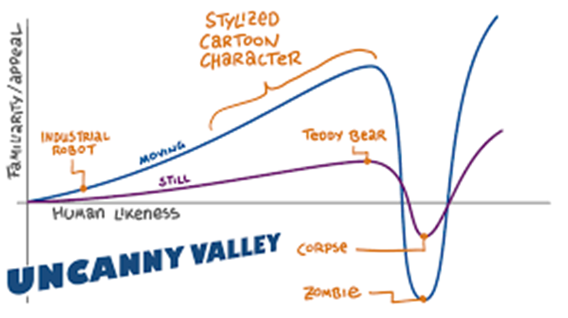
https://youtu.be/IhVu2hxm07E
Notes:
Originally coined by Masahiro Mori in 1970, the term “uncanny valley” describes our strange revulsion toward things that appear nearly human, but not quite right. This revulsion usually involves robots, but can also include computer animations and some medical conditions.
Image: Wikipedia/Smurrayinchester via CC by SA 3.0
One theory is that our experience with the uncanny valley (the “valley” being the “region of negative emotional response” in the chart over there) stems from an evolutionary tendency to be repulsed by anyone who looks sick or unhealthy or wrong.
In other words, “pathogen avoidance.”
Another is that the uncanny valley, particularly in regards to humanoid robots, triggers an innate fear of death, as they often seem to move like lifeless puppets, reminding us of our own mortality.

Slide 10
The connection between a quality solution and benefit realization is individuals embracing and adopting the change.
A perfectly designed process… that no one follows produces no improvement in performance
Like any other change, technology requires people to change their behaviour….
… not to be confused with changing their attitudes or persuading them to change!
Perfectly designed technology… that no one uses creates no additional value to the organization
Perfectly defined job roles… that are not fulfilled by employees deliver no sustained results
Notes:
We’ve all encountered these scenarios, I am sure
And the reason comes down to ignoring the human factors – the behavioural change that is needed
WHAT IS THE ROLE AS AUDITORS IN ENSURING THIS IS ADDRESSED??
Organisational change is dependent on each individual changing
How much change management is needed?
Depends on the amount of disruption created in individual employee's day-to-day work and the organization attributes like culture, value system and history with past changes
Mismanaging the people side of change has real consequences for project performance - Project delays, Budget overruns, Resistance, Resources not made available, Project fails to deliver results
The organizational costs and risks of poorly managing change include - Productivity plunges (deep and sustained), Loss of valued employees, Reduced quality of work, Impact on customers, Morale declines, Legacy of failed change
Effective change management:
Unlocks resistance to change
Enables people to work effectively to deal with and embrace change
Speeds up the implementation of change initiatives
Accelerates the realisation of benefits

Slide 11
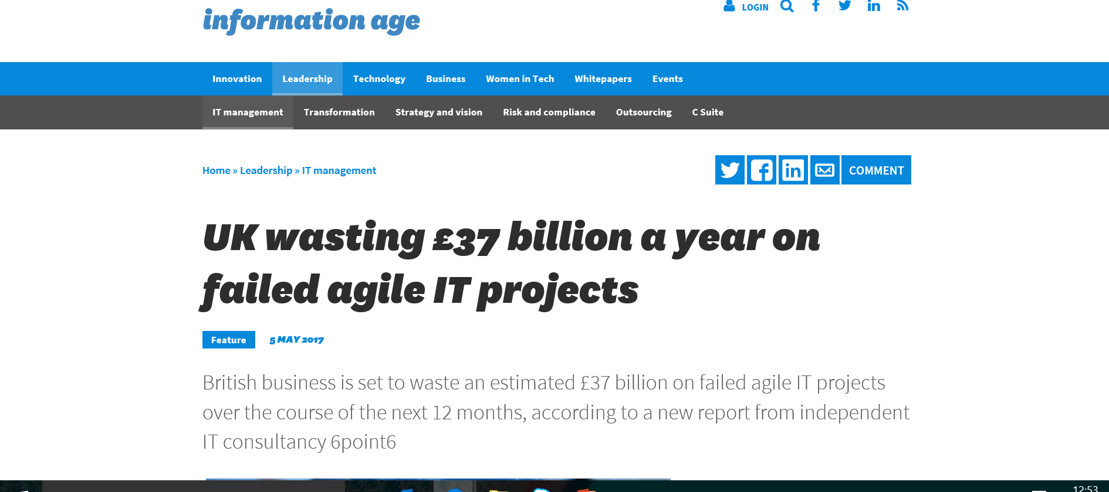
Why worry?
Notes:
WE JUST CAN’T AFFORD FOR THESE INVESTMENTS TO FAIL
£37 billion a year!!!!!!!
Does anyone have that kind of money to waste?!
2013: Parliament's public spending watchdog reported in 2013 that the abandoned NHS patient record system has so far cost the taxpayer nearly £10bn and the final bill expected to be higher
The tax payers alliance estimated the UK government has wasted more than £100 million in taxpayers money on failed or cancelled IT projects in just one year.
The figure comes from the TaxPayers' Alliance, analysis of spending of all departments for the year 2013-14.

Slide 12
What’s required to deliver change successfully?
Organisational culture and paradigm
Leadership
Management
Values and motivations
Skills
The dynamic
The Human Factors
Roles
Process
Structure
Systems
KPIs
Notes:
So often, too little time is spent on the human factors – what’s often called the “soft stuff” – these take primacy over the hard stuff: the process and structure aspects.
Really, those things should be designed to influence the human factors
And perhaps stop thinking of it as TECHNOLOGY – it’s change

Slide 13

How much time do we spend on these?...
A Awareness of the need for change
D Desire to participate and support the change
K Knowledge on how to change
A Ability to implement required skills and behaviours
R Reinforcement to sustain the change
A
D
K
A
R
Notes:
There are several models for change management –
I am selecting this one simply for illustration
How much time and resource is invested in these?
Even the smartest people still get it wrong
One of the FDs at my presentation in February was leading implementation of a new ERP (enterprise resource planning) system. At that time, there was no change management plan
Another client had signed up to be one of the first UK councils to use the new Oracle system… Yet no change management plan, not even compregensive training and floor walkers. And they wondered why only 20% of people using the system. And this was system for fin management!!!!!!!!!!!!!!!!

Slide 14
Making it Stick - change behaviours not opinion or attitude
It takes 12 weeks* to develop a habit…
The Art of Behavioural Science
- MINDSPACE
- Values Modes
Forget the rational actor model – stop trying to persuade people!
Engage on a human level – we are emotional beings
Go with the grain of human behaviour
Recognise the change curve – people get there at different speed
Practise, prototype, and experiment
* A common rule of thumb; it can take anywhere from two months to eight months to build a new behaviour into your life
Notes:
Even when projects realise they need to think about the people angle of a technology project, a classic pitfall is the way they engage with them
Communication focuses on the rational and logical reasons why we need this
BUT that just doesn’t land
We need to tap into what makes them tick – what motivates them, what incentivises them….
And that’s where behavioural science comes in

Slide 15

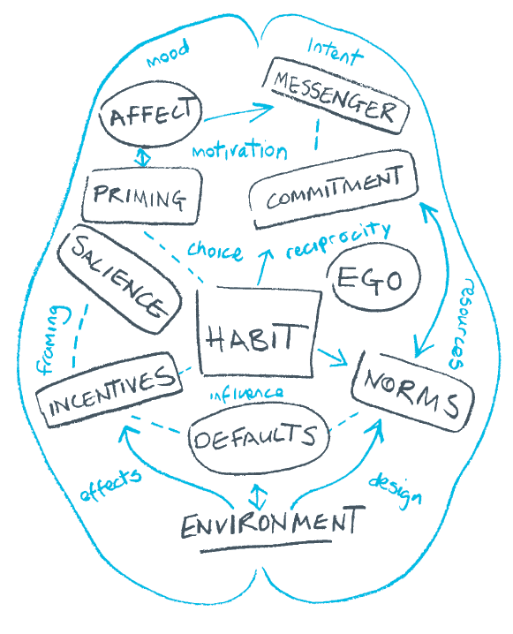
MINDSPACE
A framework to develop interventions that will influence behaviour.
It is a behavioural science tool that was founded by leading psychologists and economists.
MINDSPACE recognises that there is a difference between what people say they will do and what they actually do.
A small change can make a big difference.

Slide 16
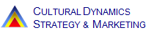
Knowing your audience| VALUES MODES
 | “Settlers” | “Prospectors” | “Pioneers”
Characteristics | Traditional. Like ‘top-down’ messages. Naturally conservative and risk averse. Driven by unmet need for safety, identity, belonging. Wary of change – nostalgic about past. Low sense of ability to effect change. | Guided by external influences (e.g. people, money, status, power). Status oriented – do things because they are cool / fashionable / clever. Draw esteem from others. | Guided by their own sense of ‘right’ & ‘wrong’. This is deeply emotional and informs rational decisions. Strong ‘Self-efficacy’. Less worried about others’ perceptions of them. More creative. Most empathetic.
Behaviour | ‘Follow the crowd’. Least empathy of the groups. More likely to get family (often extended family) to help out with some tasks. Can be inflamed by threats. Pessimistic about future. | Smarter dressed. “Don’t want to look stupid”. “All about me- how does it affect me?” Unlikely to come up with ideas. “Keeping up with the Jones’” | More likely to volunteer. ‘If the rules don’t let me do it, change the rules’. Issues that concern them are local / within control. Come up with ideas / solutions.
Notes:
Talk through – model design for understanding people’s intrinsic motivations and values – i.e. what drives their behaviour
BUT achieving same behaviour does not necessarily require the same motivation
e.g.
Recycling
Pioneers – been pushing for this for years; frustrated it’s taken so long and we are still behind
Settlers – do it because we have told them to – it’s the rules and everyone else is doing it
Prospects – there’s the challenge: they aren’t motivated in same way as the other two. We need to make it easy and cool

Slide 17
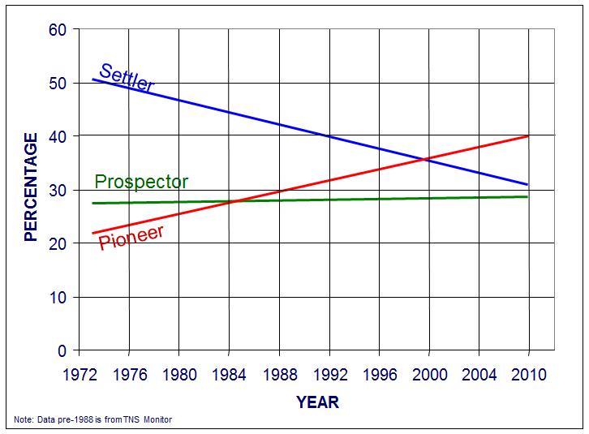
The national breakdown of Value Modes
Notes:
What do you think country is?
We have a system and services designed for a population of the 1970s/1980s
There are fluctuations from data point to data point, but the trends are consistent and robust over time. The cross over points are a function of the time line but Settler and Pioneer are now the two largest groups in 2009. But Settler will continue long term to decline and Pioneer will continue long term growth.

Slide 18
Value Mode Breakdown: Grade
Notes:
Surveyed c 20 different councils to determine which values mode their workforce was
We cut that by department and levels – some common patterns / trends
The proportion of pioneers increased significantly with the grade level (67% in the SMT)
The proportion of settlers decreased significantly with grade level (0 % in the SMT)
The proportion of prospectors decreased marginally with grade level
So just think for a moment – how are is the senior management team going to communicate effectively and motivate the 21% settlers at levels 1-4?!

Slide 19
Summing Up
Technology is here, it’s exciting, and we should take advantage of it.
It should be an integral part of our lives (work and social) – not an add-on.
Technology offers a significant opportunity – both for improving outcomes and addressing the financial challenge.
We need to take it seriously and catch up with the rest of the world.
BUT
Don’t underestimate the people challenge - it needs as much creativity, innovation and focus as the technology itself!
Behavioural science should underpin the approach to change management.

Slide 20
Contact
References
Martin Cresswell, CEO
e: mcresswell@impower.co.uk m: 07912 300 216
www.impower.co.uk
Why Projects Fail
http://calleam.com/WTPF/?page_id=2338
Uncanny Valley Examples
https://www.strangerdimensions.com/2013/11/25/10-creepy-examples-uncanny-valley/
Values Modes
http://www.cultdyn.co.uk/valuesmodes.html
MINDSPACE
https://www.instituteforgovernment.org.uk/sites/default/files/publications/MINDSPACE.pdf

