Slide 1

WALK THE LINE
STEPHANIE DONALDSON
GOVERNMENT INTERNAL AUDIT AGENCY
3 March 2019

Slide 2

WALK THE LINE
INTRODUCTION
ORGANISATIONAL POSITION OF INTERNAL AUDIT
CIPFA STATEMENT: ROLE OF THE HEAD OF INTERNAL AUDIT (Revised 2019)
CIPFA ETHICS SURVEY / ETHICS WORKING GROUP
DRAWING “THE LINE”

Slide 3


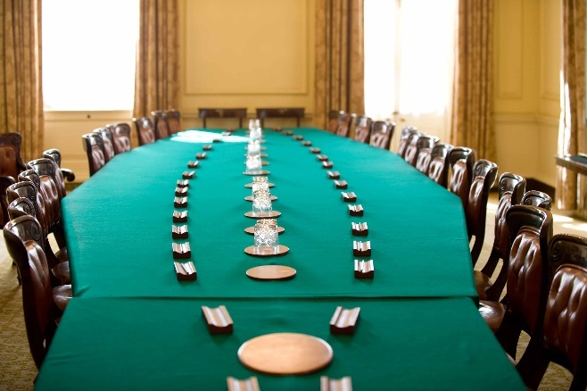

INTRODUCTION

Slide 4

INTRODUCTION
CIPFA NW Vice President
Chair CIPFA TIS Editorial Board
CIPFA IA Special Interest Group (SIG) Member
  CIPFA Statement on Role of the HoIA
CIPFA Ethics Working Group Member
  Ethics Survey (2018)
  SOPP on Ethics (2018)

Slide 5
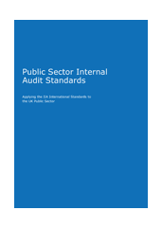
THE ORGANISATIONAL
POSITION OF INTERNAL AUDIT
PSIAS – Defines IA as “an independent, objective assurance and consulting activity designed to add value and improve an organisation’s operations”
Standard 1000 – Purpose, Authority & Responsibility
The Internal Audit Charter establishes the IA activity’s position within the organisation;
CAE functional reporting relationship with the Board (Audit Cttee)
Describes safeguards to limit independence or objectivity
1100/ 1100 – Independence & Objectivity
“freedom from conditions that threaten the ability……to carry out
  IA responsibilities in an unbiased manner”
“threats to independence must be managed”
“objectivity is an unbiased mental attitude”
“do not subordinate…judgement on audit matters to others”
“CAE must…have free and unfettered access to the Chief
Executive (or equivalent) and Chair of the Audit Committee

Slide 6
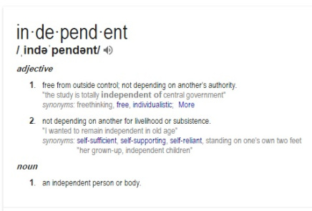
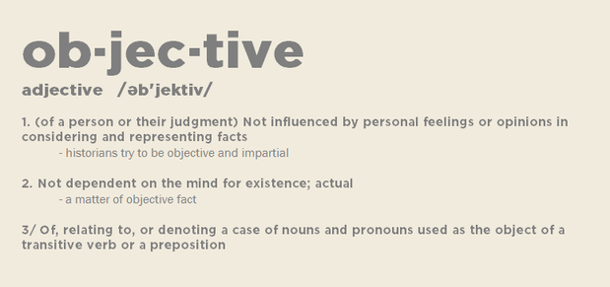
THE ORGANISATIONAL
POSITION OF INTERNAL AUDIT
CRITICAL FRIEND

Slide 7
THE ORGANISATIONAL
POSITION OF INTERNAL AUDIT
RETAIL
Internal Audit based in Head Office - Delivered compliance audit across the company;
Function reports directly to CEO / Board;
1 or 2 Internal Audits per year in each store;
Unannounced (unless pre-arranged for new managers);
Programme determined centrally; scope not agreed with auditees;
Often internal audit performance was linked to store KPI’s (and / or store manager’s bonus);
Internal Audit also led counter-fraud and investigation work;
Perceived as “police” function (IIA survey in 2016: “IA seen as “the enemy” in the retail sector)

Slide 8
THE ORGANISATIONAL
POSITION OF INTERNAL AUDIT
LOCAL GOVERNMENT
Internal Audit employed by the organisation;
CAE / HoIA will attend Senior Management Team (or equivalent);
CAE / HoIA does not report directly to Chief Executive (often s.151 / Treasurer or equivalent);
“unfettered access” to Chief Executive / Chair of Audit Cttee;
Internal Audit Plan agreed with each Department on an annual basis;
Scope of each review agreed in advance;
Auditee has input into report drafting process;
Internal Audit may have responsibility for other operational areas (examples include risk management, scrutiny, health & safety, information management)

Slide 9
THE ORGANISATIONAL
POSITION OF INTERNAL AUDIT
CENTRAL GOVERNMENT (GIAA)
Provide IA services to 14 Government Departments (and over 120 ALB’s);
GIAA is an ALB of HM Treasury;
Not employed by the customers we provide services to;
Do not attend ExCo, OpCo, Board meetings or equivalent (unless requested);
Plans are agreed on an annual basis (and associated fees);
Consultancy work provided if requested (chargeable time);
Operate in compliance with the PSIAS;
Stakeholder Engagement Plans agreed to manage
customer relationships

Slide 10
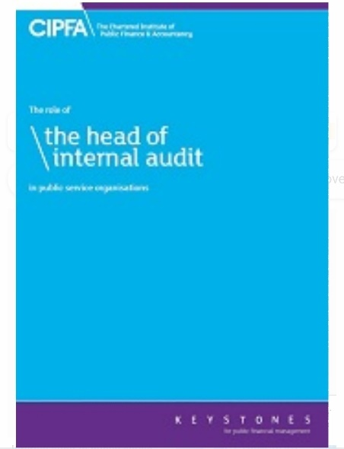
CIPFA STATEMENT:
THE ROLE OF THE HEAD
OF INTERNAL AUDIT
Revised 2018/19
Launch date 9 April 2019
Updated to reflect the revised PSIAS
Defines five principles for the core activities and
behaviours of the role of the HoIA in public service organisations
Considers the organisational arrangements needed to support them
Sets out the governance arrangements required within an organisation to ensure that HIAs are able to operate effectively and perform their core duties
Details personal skills, professional standards, leadership skills and technical expertise organisations can expect from their HIA

Slide 11
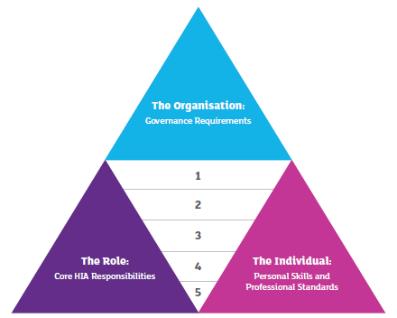
CIPFA STATEMENT:
ROLE OF THE HEAD OF INTERNAL AUDIT
The Five Principles

Slide 12
CIPFA STATEMENT:
ROLE OF THE HEAD OF INTERNAL AUDIT
“Demonstrates competence and due professional care”
The Five Principles
“Demonstrates integrity”
“challenging and supporting the Leadership team with authority and credibility”
“ independent of operational
management”
“Promote the highest standards of ethics”
“protect independence and objectivity”
“risks to independence must be recognised”
“The HIA must adhere to the professional values of accuracy, honesty, integrity, objectivity, impartiality, transparency, confidentiality, competence and reliability and promote these throughout the internal audit service”
“integrity, objectivity, competence and confidentiality”
“appropriate reporting lines”
“objective and free from undue influence”
“Is appropriately positioned and adequately resourced”
“provide credibly constructive challenge to management”
“sufficiently senior and independent within the organisation’s structure”
“unfettered rights of access for internal audit to all papers and all people in the organisation”
“direct access to the chief executive”
“Escalate any concerns about maintaining independence”
“Adhere to professional internal audit and ethical standards”

Slide 13
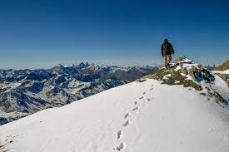
CIPFA STATEMENT:
THE ROLE OF THE HEAD
OF INTERNAL AUDIT
BIGGEST CHALLENGES?
Assurance | v. | Consultancy
Detachment | v. | Customer Intimacy
“Insider” | v. | “Outsider”
Other operational Roles
Direct Line Management
Maintaining objectivity
Other influences / factors

Slide 14
CIPFA ETHICS SURVEY &
ETHICS WORKING GROUP
CIPFA Ethics Survey of members and other public sector accountants about ethical in Summer 2018
The results found that 57% of the 487 respondents said they had been put under pressure or felt under pressure to act in a professionally unethical way.
Of those who felt under pressure, 8% said they had fully carried out an unethical action, and 28% had done so partially.
“Top 3” most cited unethical actions were:
Supporting excessively optimistic budgets and business cases (179)
Dodging policies, standing orders and other regulations (164)
Unreasonably downplaying risks (132)
88 respondents said that they had been asked not to disclose material facts in a report

Slide 15

CIPFA ETHICS SURVEY &
ETHICS WORKING GROUP
487 RESPONDENTS
CIPFA 77%
Qualified 86%
70% qualified 10+ years
Sectors:
Local Government 239 NHS 52 Civil Service / Regulator 41 Charity / NfP / Housing 23 FE / HE / Schools 15
Police / Fire 14 Audit Firm 12
Other incl Consultants, Commercial 56
Retired / not working / break 35

Slide 16

CIPFA ETHICS SURVEY &
ETHICS WORKING GROUP
18 Questions in total
Have you ever been put or felt under pressure to act unethically? How many times?
Who put you under pressure?
What were you asked to do?
Were you offered incentives?
Did you feel under threat?
Did you undertake the unethical task?
What consequences did you experience?
Have you read your Institute’s Code of Ethics in last 3 years?

Slide 17
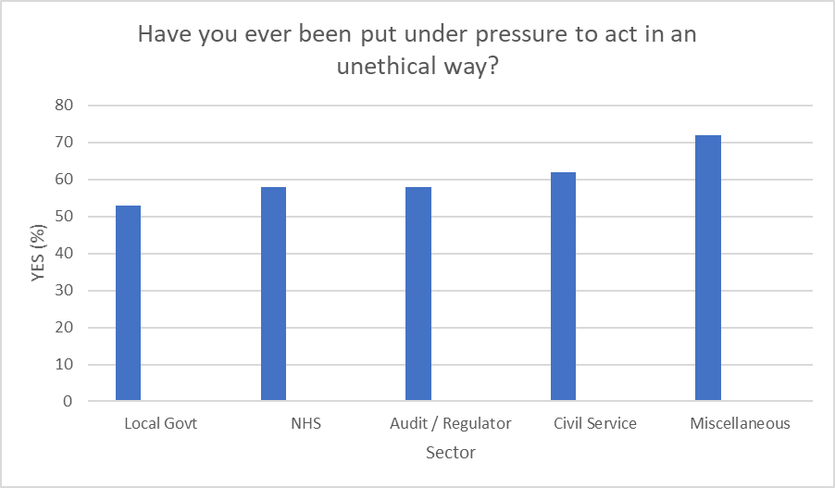
CIPFA ETHICS SURVEY &
ETHICS WORKING GROUP

Slide 18
CIPFA ETHICS SURVEY &
ETHICS WORKING GROUP
Who put you under pressure?
External / Internal Audit |  | 6
Regulator |  |  | 15
Board / Cabinet / Council |  |  | 18
Supplier / Customer |  |  | 21
Other (not specified) |  |  |  | 47
Line Manager |  |  |  |  | 129
CFO / FD/ CEO / Director |  |  |  |  |  | 144

Slide 19
CIPFA ETHICS SURVEY &
ETHICS WORKING GROUP
36% of the respondents who were put under pressure carried out the task (fully or partially)
64% in NHS
45% in Local Government
38% in Civil Service
9% in Audit / Regulator

Slide 20

CIPFA ETHICS SURVEY &
ETHICS WORKING GROUP
CIPFA Winter Internal Audit Update: Ethical Dilemmas faced by Internal Auditors:
Change what is said within Audit Reports
Not report to audit committee on findings
Delay or disregard review of high risks areas
Limit and change scope of audits
Pressure influence a special investigation: eg: find evidence to support guilt
Delay finalisation of reporting to allow recommendations to be actioned so final report looks better
Keep audit results provisional / draft to avoid wider reporting
Reduce overall resources disproportionally or threat of reduced resource
Investigation parked as individuals concerned leaves

Slide 21
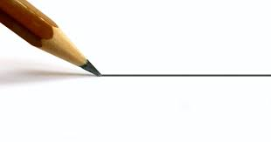

DRAWING “THE LINE”?
Ethics Survey - Less than 500 respondents
Internal Audit Survey – Less than 100
Where do you draw the line?
If you felt under pressure to “cross the line” or “toe the line”……
what would you do?

Slide 22
CIPFA ETHICS SURVEY &
ETHICS WORKING GROUP
What were the consequences?
Disciplined |  | 12
Made redundant |  |  | 21
Improved relationship |  |  | 25
Moved from Role |  |  | 28
Resigned |  |  | 33
Excluded / overlooked |  |  |  | 58
Other |  |  |  |  | 77

Slide 23
CIPFA ETHICS SURVEY &
ETHICS WORKING GROUP
CIPFA adopted a new Statement of Professional Practice (SOPP) in line with the International Ethics Standards Board for Accountants (IESBA) Code of Ethics on 1 November 2018.
As the only body specifically for public finance professionals worldwide, CIPFA brings together an international network able to offer support to these individuals as they face ethical dilemmas.
Any public finance professional concerned about an ethical dilemma they are facing at their work can get in touch with experts via the Ethics Helpline: Ethics@cipfa.org
For guidance and other information:
https://www.cipfa.org/members/conduct-and-ethics

Slide 24
THANKYOU
Questions?
STEPHANIE DONALDSON
GOVERNMENT INTERNAL AUDIT AGENCY
Stephanie.Donaldson@giaa.gov.uk

